Slide 1
Attribute Learning System
Austin Cory Bart
K. Alnajar

Slide 2
What’s the problem?
Time
Inefficiency
Tricky

Slide 3
Some Motivation
Papers
Games
A Temporal Data-Driven Player Model for Dynamic Difficulty Adjustment
Pokemon
League of Legends

Slide 4
Possible Solution and design
Modifiers
Utility Criteria
Attributes
Genetics

Slide 5
Utility Calculation
Battle Victory
Move Usage
Move Utility

Slide 6
Looking at Genetics
Mutations
Crossovers
Genetic Algorithm

Slide 7
Genetic Types
method1
Trees
method2
Vectors

Slide 8
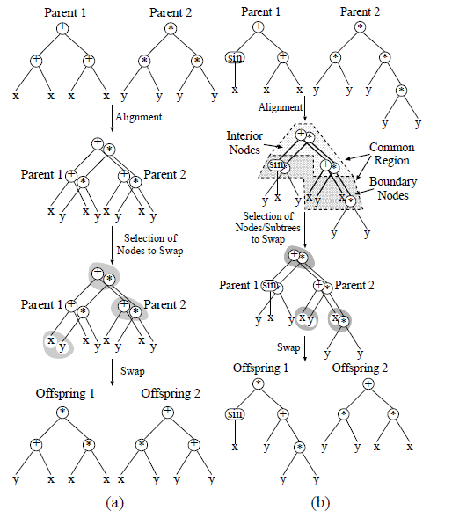
Method 1 – function Tress
TREE.MUTATION
Mutate leaf nodes and parents of leaf nodes of the tree, either by replacing a node with a child node or by replacing the node with a different type
TREE.CROSS_OVER
Swap corresponding interior node of one tree with that of another tree
Poli R., Langdon W.B. On the search properties of different crossover operators in genetic programming. In J. R. Koza, et al., editors, Genetic Programming 1998:Proceedings of the Third Annual Conference, pages 293-301, University of Wisconsin, Madison, Wisconsin, USA, 22-25 July 1998.

Slide 9
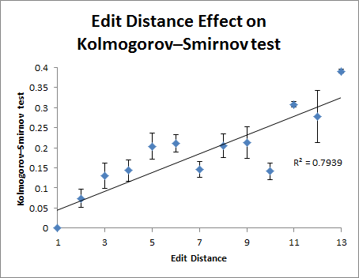
But mutation affects the output too much

Slide 10
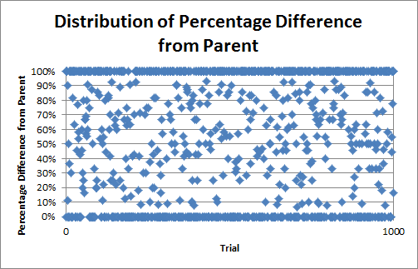
Cross-over is not an average

Slide 11
Method 2 - Linear Transformations
VECTOR.MUTATION
Change the coefficient of a given attribute by some small amount
VECTOR.CROSS_OVER
Find the average of a coefficient given a shared modifier
Allows for finer tuning and changes
Ex. Damage = (2.0 * self attack) – (1.5 * opponent’s defense) + 5

Slide 12
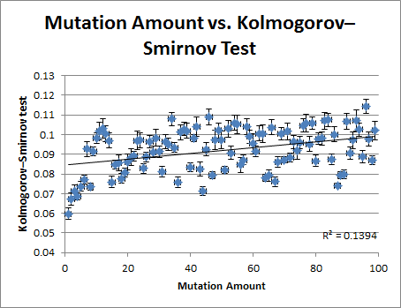
Much finer state exploration

Slide 13
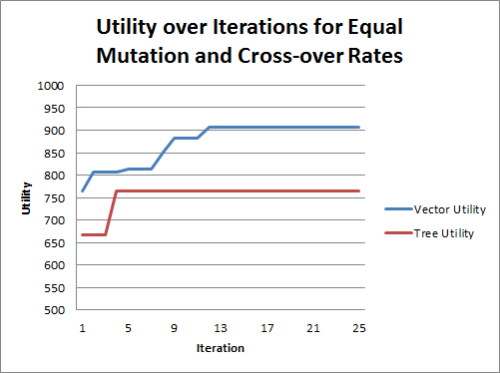
Preliminary Results
Vector outperformed Tree

Slide 14
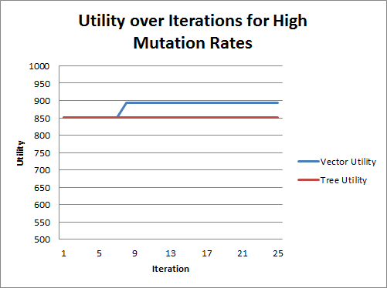
Preliminary Results
Mutation had an important impact on trees

Slide 15
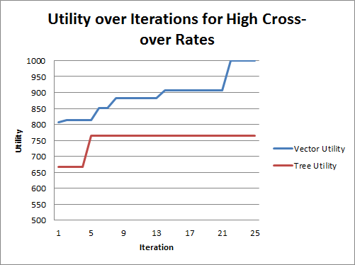
Preliminary Results
But cross-over was key to improving vectors

Slide 16
a 1000-utility vector move
other_health= -.72 * other_attack + .77 * self_attack - .17 * self_defense+ 3.43 * other_defense+ 1.2
other_attack = -11 * other_attack – other_health - 13 * other_defense - 2 * self_attack+ 8 * self_defense+ self_health+ 1
self_health = -3.71 * self_attack - 1.97 * self_defense + 1.83
----------------------------------------------------------------------------------------------------------------------------------------
other_health= -other_attack+ 4 * self_attack + 2 * self_defense+ other_defense + 2
other_defense = -.88 * other_attack - 3*.72 *other_health - 2.38 * other_defense+ 3.31 * self_attack - 5.19 * self_defense+ 3.69 * self_health- 4.56
self_health= -self_attack- 6 * self_defense+ 9

Slide 17
Things That Did Not Work
“Mirroring” Moves
Identical moves for players in simulation showed little improvement
Confusing Utilities
Tried many combinations and calculations of criteria for determining utility of moves
Move Merging
Challenge of crossing over moves with different features

Slide 18
Future Things
Short Term
Long Term
Using more parameters
Enhancements to Constrained Novelty Search: Two-Population Novelty Search for Generating Game Content (2013)
Increasing attributes and types

Slide 19
The End.

